Slide 1
GCBASIC
PIC16F175xx
Part 14 - PWM many ways

Slide 2

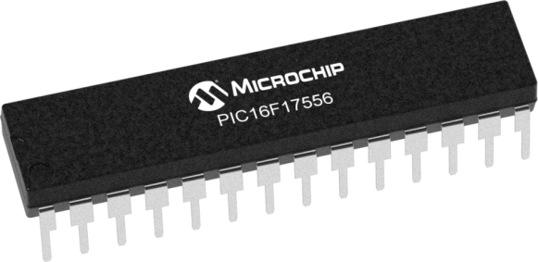
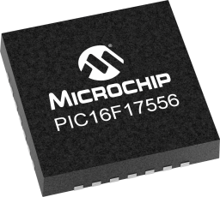
GCBASIC
PIC16F175xx
Part 14 - PWM many ways

Slide 3
GCBASIC
Like and subscribe!

Slide 4
Videos...
Install the hardware and make the board work – three LED programs
Make four LEDs flash in a sequence
Set the LEDs to represent the value of ADC
Sequence the LEDs with a delay using the value of ADC
Using an input to set the state of the LEDs
Using the reset switch
Using the switch, ADC – make the LEDs flash in a sequence with reverse
Using the serial to display values
Using the timer0 overflow, 8bit timer, 16bit timer to flash the LEDs
Using EEProm – showing values on the serial terminal, and more constants insights
Using I2C with serial to discover I2C devices
Using I2C GCLD display solutions
Using a SPI GLCD display solutions
Using PWM, many ways, to dim the LEDS
Using millis()
Using storage within the chip – Progmem, SAF memory, EEPROM and DATA blocks
Using CLC
The GCBASIC tool chain
Assembly , alternatives assemblers and MPLAB-X
Summary

Slide 5
PIC16F175xx
PIC16175xx is a high performance PIC16
Digital and analog peripherals for flexible embedded control
10-bit ADC for accurate analog signal conversion
Multiple communication interfaces including UART (serial), I²C, and SPI
PWM modules with CCP and 16-bit resolution for precise timing and motor control
Configurable Logic Cells (CLCs) for custom hardware-level logic without external components
Integrated op amps for onboard analog signal conditioning and amplification
The PIC16175xx offers 14, 20, 28, 40 and 44-pin products in small footprint packages to support customers in a wide variety of applications.

Slide 6
GCBASIC Compiler
GCBASIC Compiler
GCBASIC is an Open Source compiler for PIC, AVR and LGT microcontrollers
GCBASIC now supports the 16F175xx chip family

Slide 7
Prerequisites
Assumes you have
Installed the GCBASIC software
Installed your programmer software
Test that you have the 16F175xx attached
You have the 4 LEDs operating

Slide 8
Hardware
Hardware // -------------------PORTA----------------
// Bit#: -7---6---5---4---3---2---1---0---
// IO: ------------------------------ADC-
// ----------------------------------
// -------------------PORTB----------------
// Bit#: -7---6---5---4---3---2---1---0---
// IO: ---------------------------------
// ---------------------------------
// ------------------PORTC-----------------
// Bit#: -7---6---5---4---3---2---1---0---
// IO: ----------------LED-LED-LED-LED--
// ---------------------------------
//
// ------------------PORTE-----------------
// Bit#: -7---6---5---4---3---2---1---0---
// IO: ----------------MCLR-------------
// -----------------SW--------------
Prototype Board
Power 5v0
Programmer
LEDs & resistors

Slide 10
Pulse Width Modulation
Pulse Width Modulation ( PWM ) is simply a succession of pulses – is a method of reducing the average power delivered by an electrical signal, by effectively chopping it up into discrete parts.
The average value of voltage (and current) fed to the load is controlled by turning on and off at a fast rate. The longer the signal is on compared to the off periods, the higher the total power supplied to the load.

Slide 11
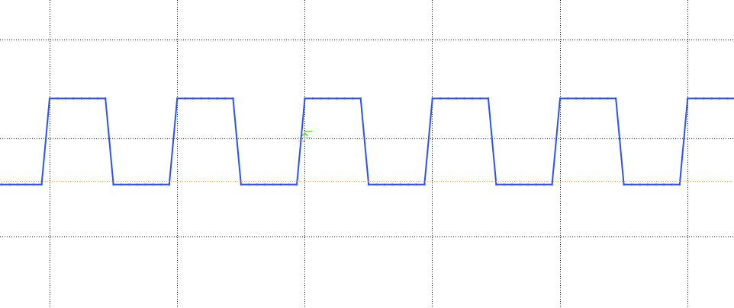
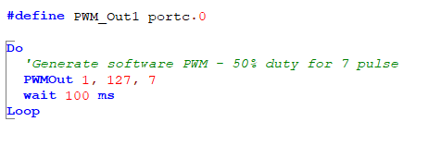
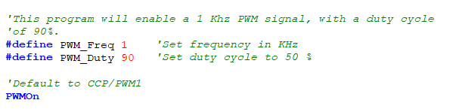
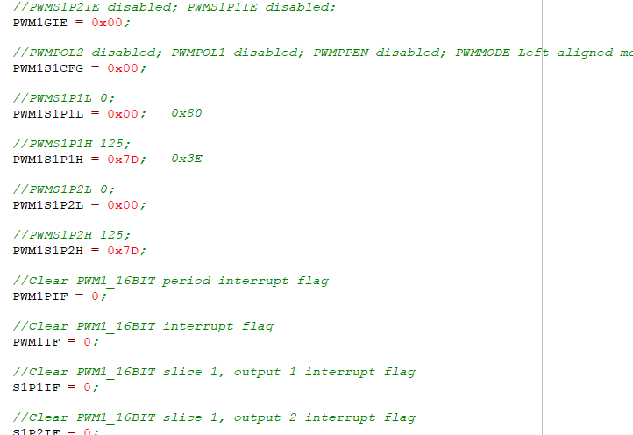
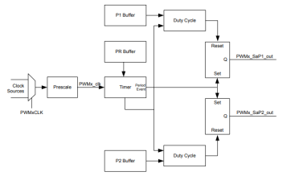
PWM

Slide 12
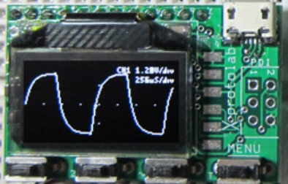
Setup
http://www.gabotronics.com/development-boards/xmega-xminilab.htm

Slide 13
PWM
 | PWM type | Characteristics | PPS required | Comment
1 | The simplest way | Port on and off | No | Any port**
2 | The pulseout() way | PulseOut() a port for a period | No | Any port**
3 | The PWMOut() way | PWMOUT() a number of pulses | No | Any port**
4 | CCP/PWM way | Fixed frequency, fixed duty using timer2* | Yes – CCP/PWMx module | Low code impact, two constants
5 | CCP/PWM way | Variable frequency, variable duty using timer2* | Yes – CCP/PWMx module | ASM does the heavy lifting
6 | PWM 16 bit way | Wide range of capabilities | Yes - PWMxx | Lots of parameters
7 | Timer interrupt way | Use a timer1* | No | Any port**
* could use other timers
** any valid output

Slide 14
Lab
Walk the examples
And, view the Xminilab scope

Slide 16
Videos...
Install the hardware and make the board work – three LED programs
Make four LEDs flash in a sequence
Set the LEDs to represent the value of ADC
Sequence the LEDs with a delay using the value of ADC
Using an input to set the state of the LEDs
Using the reset switch
Using the switch, ADC – make the LEDs flash in a sequence with reverse
Using the serial to display values
Using the timer0 overflow, 8bit timer, 16bit timer to flash the LEDs
Using EEProm – showing values on the serial terminal, and more constants insights
Using I2C with serial to discover I2C devices
Using I2C GCLD display solutions
Using a SPI GLCD display solutions
Using PWM, 6 ways, to dim the LEDS
Using millis()
Using storage within the chip – Progmem, SAF memory, EEPROM and DATA blocks
Using CLC
The GCBASIC tool chain
Assembly , alternatives assemblers and MPLAB-X
Summary

Slide 17
GCBASIC
PIC16F175xx
Part 14 - PWM many ways

